Slide 1



Demographic Crisis and economic crisis for Italian «Mezzogiorno»:
an iceberg
detached from the continent?
Prof. Antonio Golini
47th Scientific Meeting
of the Italian Statistical Society
Cagliari - June 11/13, 2014

Slide 2
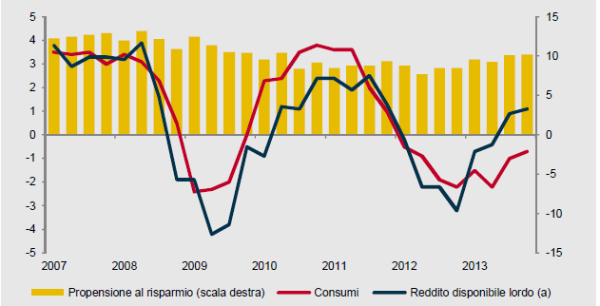
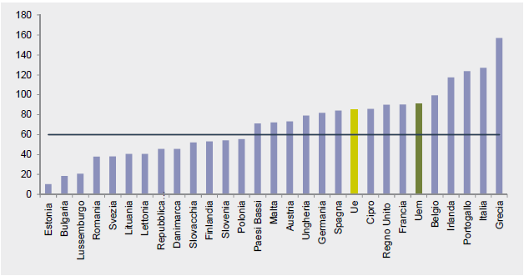
THE ITALIAN ECONOMIC FRAMEWORK \1
The Italian economy has been dramatically affected by the deterioration of the global economy, and by the negative impact of the financial and sovereign debt crisis.
Saving propension (right)
Consumption
Gross available income
UE public debt (2012) (% of the GDP)
Source: ISTAT

Slide 3
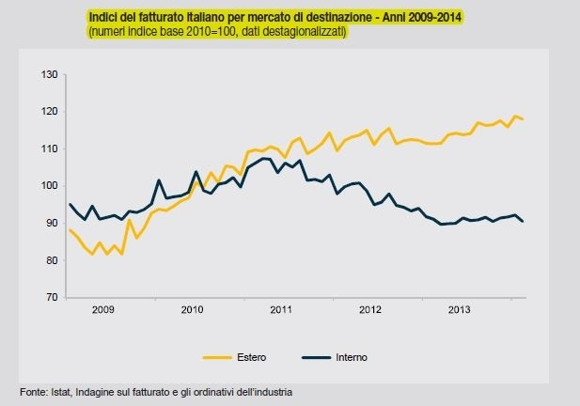
Turnover by destination market

Slide 4
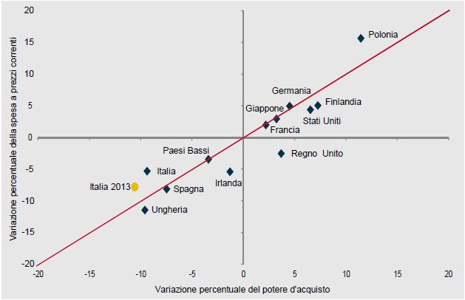
THE ITALIAN ECONOMIC FRAMEWORK \2
The severity of the tax measures; the structural and conjuntural difficulties of the Labour market; the decline in the purchasing power of households;
the weakness of the economic internal and external demand; the strong uncertainty about the prospects for growth, have led to a worrying socio-economic decay in all the Italian geographic areas.
Expenditure for final consumption and gross available income
(1995-2013)
(billions of euro)
% variation of expenditure
% variation of purchasing power
Source: ISTAT

Slide 5
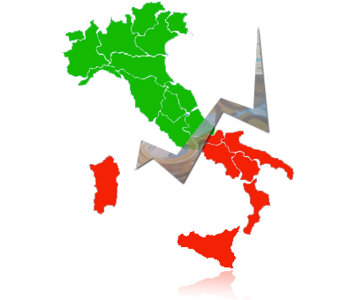
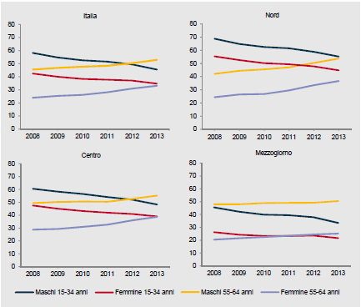
«MEZZOGIORNO»:
AN ICEBERG DETACHED FROM THE CONTINENT?
This paralyzed and confused economic framework, which affects the entire national territory, stands out with an exponential intensity and pervasiveness in the South of Italy (“Mezzogiorno”),
which both as far as key indicators of the labour market and of the socio-economic conditions are concerned, represents the “statistics queue” of the Italian breathless society and economy.
Employment rate by geographic areas, sex, age (2008-2013) (%)
Source: EUROSTAT, LFS

Slide 6
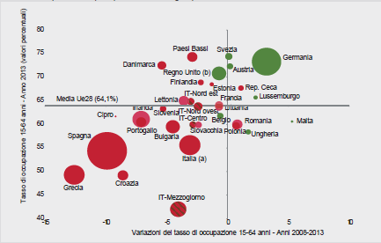
«MEZZOGIORNO»:
AN ECONOMIC, DEMOGRAPHIC AND POLITIC ICEBERG \1
Employment rate 2013 (15-64); variation 2006-2013
(Europe Countries and italian geographical areas)
Employment rate (15-64) variation (2013 - %)
Employment rate (15-64) variation (2006-2013)
The «Mezzogiorno» shows the lowest employment rate (27,6%)
Source: ISTAT

Slide 7
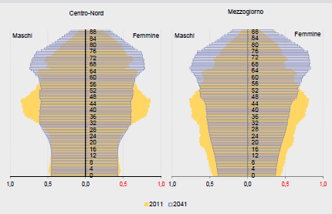
«MEZZOGIORNO»:
AN ECONOMIC, DEMOGRAPHIC AND POLITIC ICEBERG \2
An emerging and abiding demographic crisis has to be added to the economic and financial crisis because of decreasing fertility rates and a quick and intensive ageing process.
Center-North
Mezzogiorno
Male
Female
Male
Female
Source: ISTAT

Slide 8



«MEZZOGIORNO»:
AN ECONOMIC, DEMOGRAPHIC AND POLITIC ICEBERG \3
the “Mezzogiorno Iceberg” is also expected to carry back the other European countries, if considered not more than a national or local question between southern regions:
but without European shared strategies of social and economic development, starting from the “fall of the Mediterranean Wall” – which is the new fatal barrier between well-being and socio-economic backwardness – an asphyxiated doom would progressively involve all the European countries like an imploding domino.
The Union for the Mediterranean and afterwards a Euro-African Union could politically and economically be the saving solution?

Slide 9
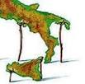
1.
MEZZOGIORNO
ECONOMIC CRISIS
and
LIVING CONDITIONS

Slide 10
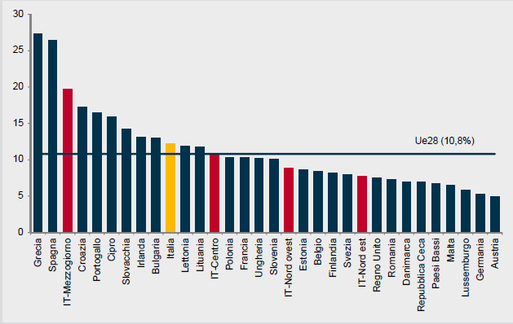
«MEZZOGIORNO»:
AN ECONOMIC, DEMOGRAPHIC AND POLITIC ICEBERG \1
In 2013 Italy the unemployment rate has reached the 12,2% (+5,4 pp. from 2008). The increasing has particularly involved the Mezzogiorno (+7,7 pp), where the indicator has reached a value of 19,7%, being the worst after Greace and Spain.
Unemployment rate (2013 - %)
Source: EUROSTAT, LFS

Slide 11
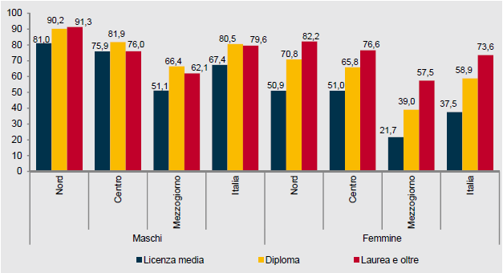
«MEZZOGIORNO»:
AN ECONOMIC, DEMOGRAPHIC AND POLITIC ICEBERG \2
Geographical differences are strongly evident even with an equal education.
Education is particularly crucial for female participation in the labor market.
Employment rate (30-34), by sex, geographical area and education (2013 - %)
MALE
FEMALE
Source: ISTAT

Slide 12
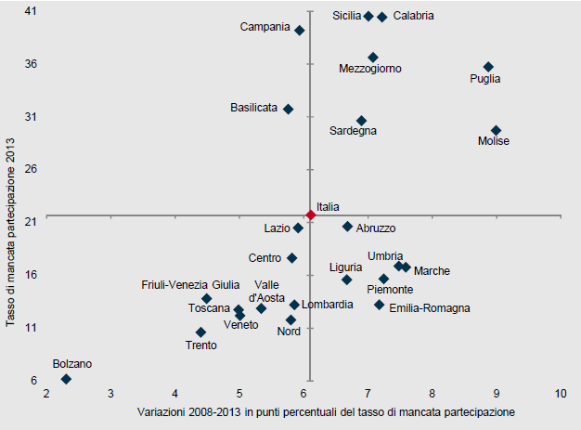
«MEZZOGIORNO»:
AN ECONOMIC, DEMOGRAPHIC AND POLITIC ICEBERG \3
Rate of «non participation» (2008-2013 )
Definitely crucial also the huge territorial gap in the rate of non-participation.
Rate of «non participation» 2013 )
Variation 2008-2013 in pp. - Rate of «non participation»
Source: ISTAT

Slide 13
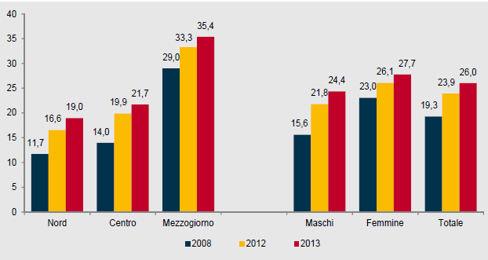
«MEZZOGIORNO»:
AN ECONOMIC, DEMOGRAPHIC AND POLITIC ICEBERG \4
The growth of “Neet” highlights the escalation of difficulties in entering the Labour market.
The presence of a large unused "young" labor supply is particularly severe in the Mezzogiorno and among women.
NEET (15-29)
Source: ISTAT

Slide 14
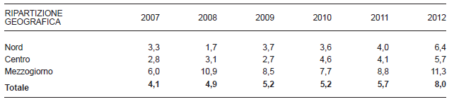
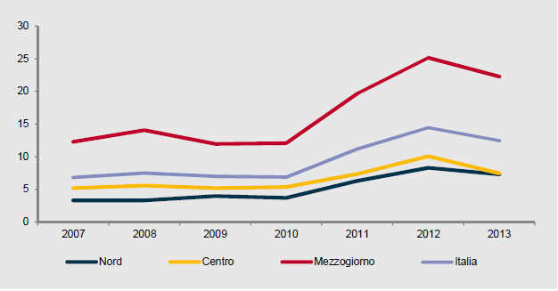
«MEZZOGIORNO»:
AN ECONOMIC, DEMOGRAPHIC AND POLITIC ICEBERG \5
ABSOLUTE POVERTY (2007-2012) (%)
Geographical areas
PERSONS WHO LIVE IN FAMILIES WITH SEVERE DEPRIVATIONS (2007-2013) (%)
Source: ISTAT

Slide 15

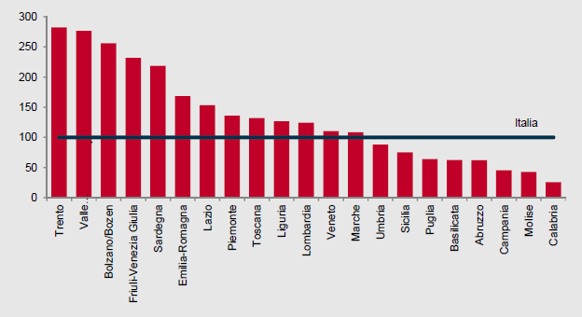
«MEZZOGIORNO»:
AN ECONOMIC, DEMOGRAPHIC AND POLITIC ICEBERG \6
Per capita expenditure on social services and assistance of the municipalities (2011)
Source: ISTAT

Slide 16
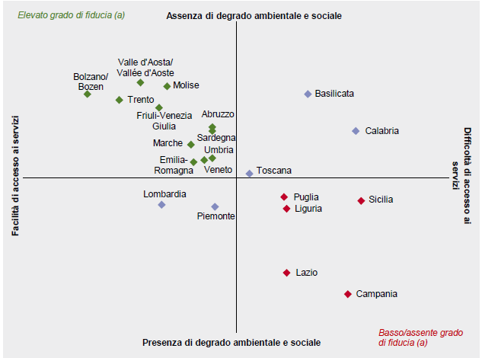
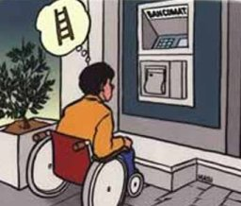
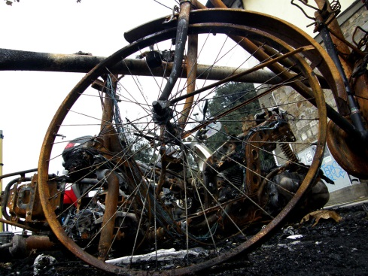
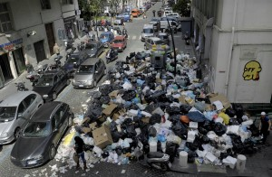
«MEZZOGIORNO»:
AN ECONOMIC, DEMOGRAPHIC AND POLITIC ICEBERG \7
High degree of confidence
Absence of social and environmental decay
Easy access to services
Difficult access to services
social and environmental decay
Low/absent degree of confidence
Source: ISTAT

Slide 17
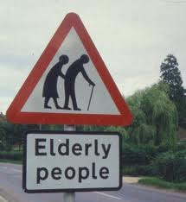
2.
MEZZOGIORNO
and
DEMOGRAPHIC CRISIS

Slide 18

MEZZOGIORNO AND THE «GENDER REVOLUTION»
The “Mezzogiorno” of Italy is passing through a deep demographic revolution, pivoting on a “gender revolution” based on women’s emancipation from the “patriarchal culture”.
The second demograhic transition has been determined and crossed by a deep and radical
recontractualisation and
reorganisation
individual and collective, cultural and economic,
of individual transitions during the life cycle;
of gender identities, relations and roles;
This evolutione/revolution of demo-social and economic-cultural structures and dynamics strictly interacts with reproductive choices, impacting on possibility and calendar of life transitions.
* M.L. Boccia, G. Zuffa, L’eclissi della madre. Fecondazione artificiale, tecniche, fantasie e norme. Pratiche editrici, Milano, 1998

Slide 19
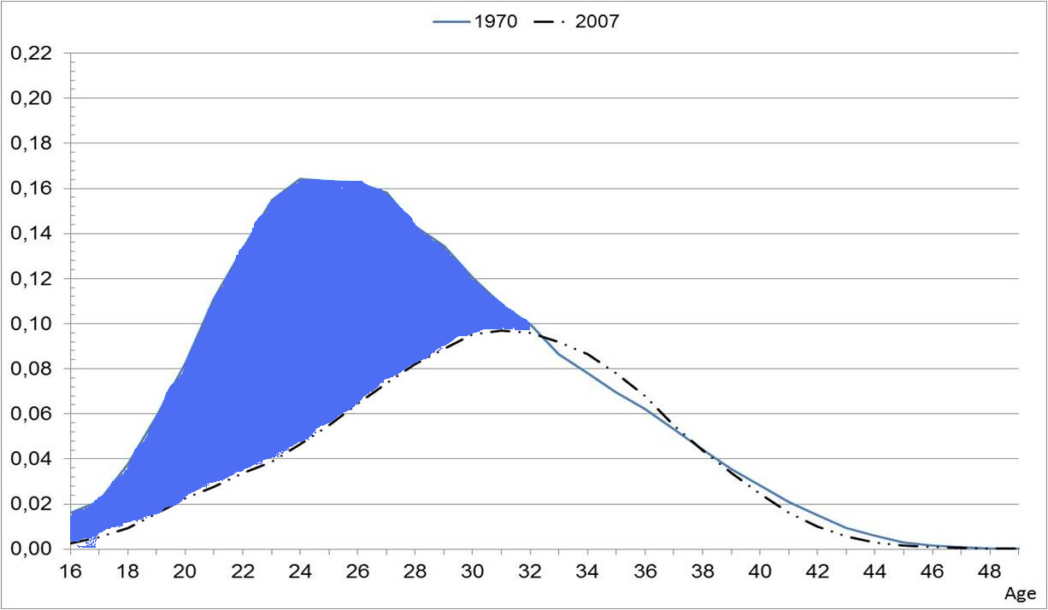
BIRTHS POSTICIPATION AND THE “DEMOGRAPHIC RESHAPING”
The Italian “Mezzogiorno” is experimenting its “demographic reshaping” in a national “demographic reshaping”.
In fact, the phenomenon of births posticipation has been reshaping our country since ’70.
Maternity has been the more and more pushed towards advanced ages.
Age specific fertility rates of women living in Italy. 1970 and 2007, values for 1.000 women
«Women’s freedom area»
Source: Eurostat (2011) e UN Statistical Division (2012)

Slide 20
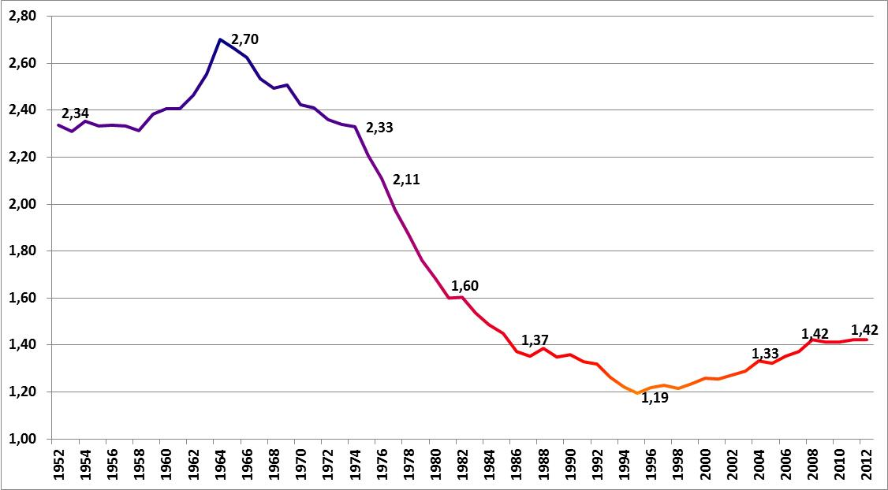
TOTAL FERTILITY RATE (R)EVOLUTION:
A DEMOGRAPHIC «MARIANA TRENCH»?
TFT – Italy (1952-2012)
SUBSTITUTION LEVEL: 2,1
1977: TFR turning point
Fonte: ISTAT, Demo.istat e I.STAT

Slide 21
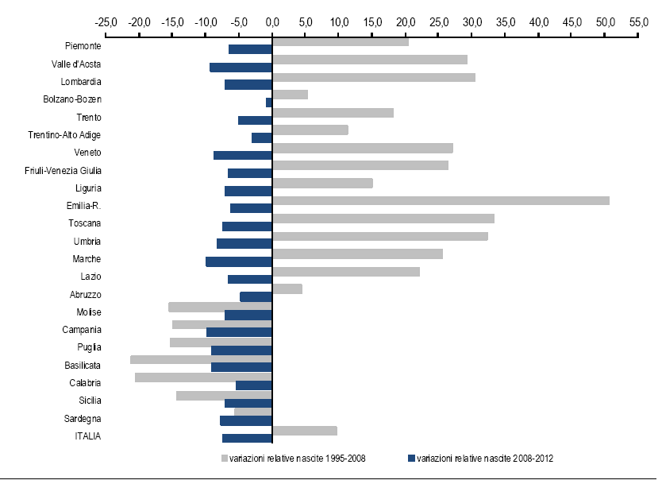
POSTICIPATION AND BIRTHS CONTRACTION
Between 1970 and 1990, Italy has been characterised by births posticipation and fertility contraction.
Women’s empowerment has determined an incredible overturning of the fertility rate: the South of Italy, which was the geographic area with the highest fertility rate in Italy, nowadays is characterized by the lowest fertility rate, also for a lack of births from foreign women.
The following weak increasing has been determined by baby-boomers, and by mothers with more than 35 years.
Nevertheless, the Mezzogiorno has been characterised by negative variations also between 1995 and 2008.
% VARIATION BIRTHS BY REGIONS.
(1995-2008 AND 2008-2012)
1995-2008
2008-2012
Source: ISTAT

Slide 22
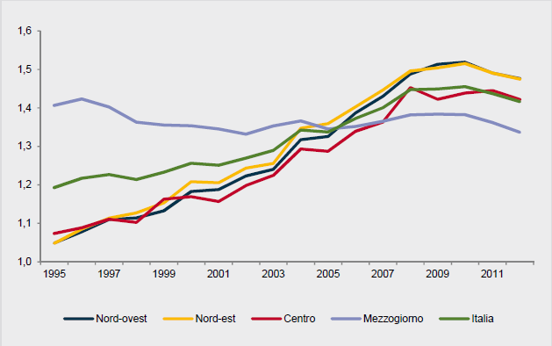


A DECLINING MEZZOGIORNO…
Total fertility rate. 1995-2011
Source: ISTAT

Slide 23
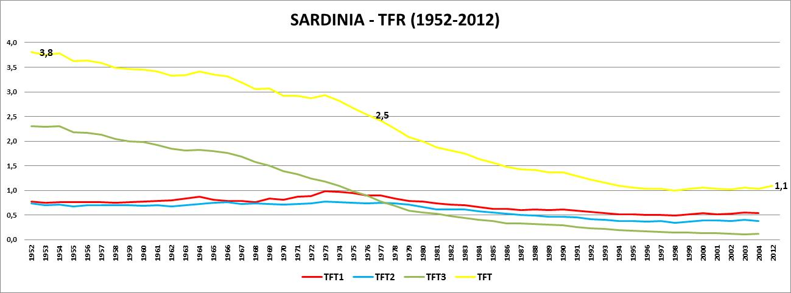
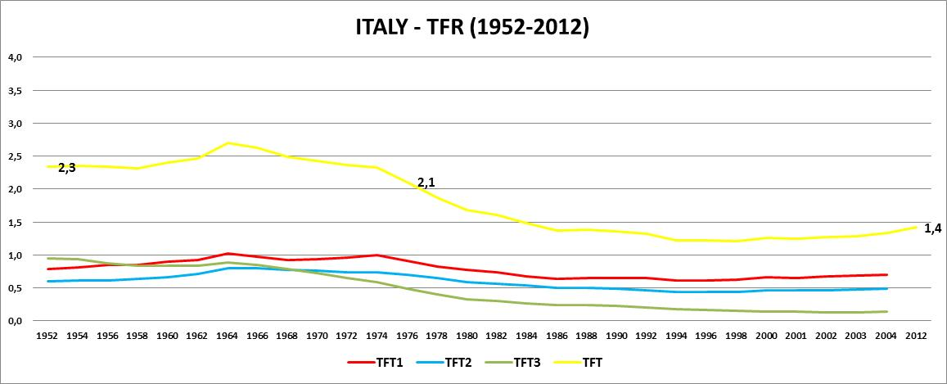
… AND THE INCREDIBLE SARDINIA:
FROM YOUNGEST REGION TO THE OLDEST ONE
Source: ISTAT, Demo.istat and I.STAT

Slide 24
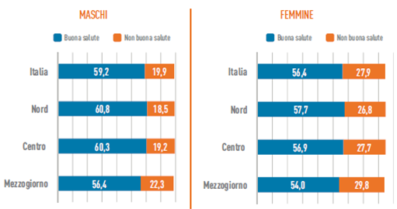
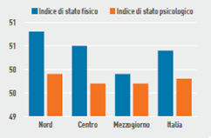
LIVING LESS, SURVIVING WORST:
THE DOUBLE WEAKNESS OF ”MEZZOGIORNO”
MALE
FEMALE
GOOD HEALTH
NOT GOOD HEALTH
GOOD HEALTH
NOT GOOD HEALTH
Physical state
Psychological state
Persons wo live in the North of Italy have a higher life expactancy and a better quality of life.
Moreover, the Mezzogiorno of Italy has also very low scores both as far as the physical and psychological wellness are concerned.
Source: ISTAT - BES

Slide 25
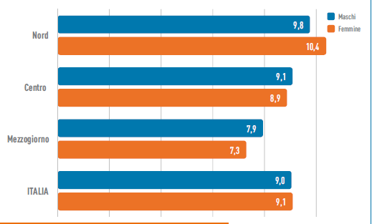
NOT PREPARED TO FACE THE AGEING PROCESS
Consequently, the South of Italy is dramatically involved in the ageing process, but without being ready to face the planetary challenge of ageing:
Nevertheless, which kind of continental, national and regional substantial economic and political supports can be reported?
Aged Men and female from Mezzogiorno have the lowest life expectancy without limitations in the daily life.
Source: ISTAT

Slide 26
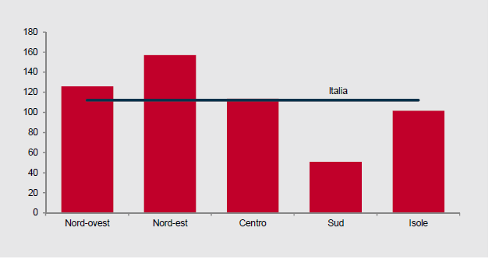
UNSUFFICIENT ASSISTANCE FOR THE ELDERLY
per capita spending on social services and assistance
for the elderly (2011)
Source: ISTAT

Slide 27

3.
MEZZOGIORNO
and
POLITICAL CRISIS

Slide 28
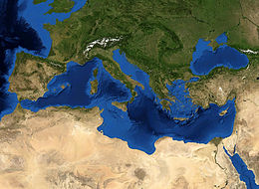
MEDITERRANEAN SEA:
WHEN «WALLS» BECOME HORIZONTAL
The Mediterranean sea
Is the new «wall”:
The «wall»
between wellbeing and poverty,
between democracy and partial democracy
Worrying human, political and economic shadows threaten both sides of the Mediterranean Sea:
The north-african side is menaced by political fragmentation and economic weakness, which determine un unprecedented migrants’ massacre;
The south-european side - Spain, Italy and Greece – is menaced by an unresolved economic crisis.

Slide 29
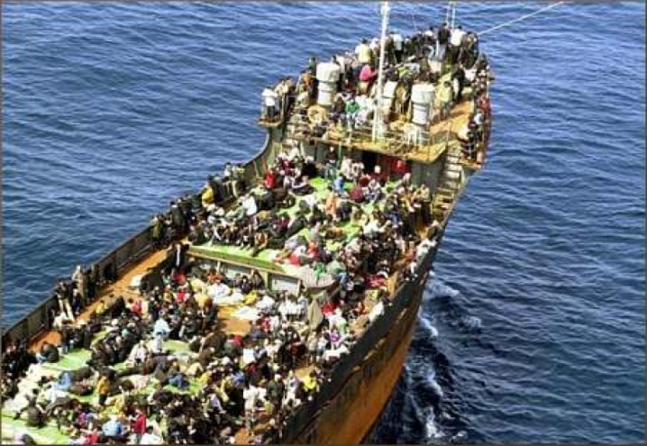

THE «FALL» OF THE «MEDITERRANEAN WALL»: URGENT AND ESSENTIAL
The fall of this “horizontal wall” should become the first geopolitic concern, especially for Europe.
But today, the major issues - present and future - in terms of peace, economy, political relations, relations between peoples (Turkey, the Israeli-Palestinian conflict, Syria and Lebanon, North Africa, sub-Saharan Africa,...) arise exactly from the Mediterranean area.
Therefore, the union of the Italian southern regions and an union of the countries of Southern Europe have to gain a compelling role in realizing the Union for the Mediterranean.
For historical, geographical and political reasons, for several decades, policy-makers’ attention has been dedicated to the East, leading to a positive widening in that area.

Slide 30
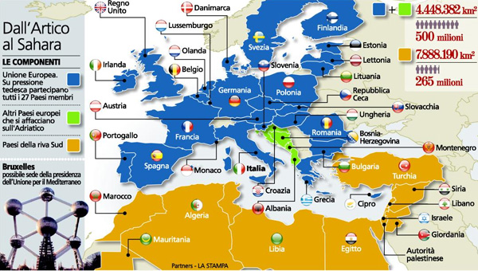
AN ECONOMIC AND POLITIC «BREATHLESS» EUROPE…
Sarkozy has raised the opportunity for a rapid implementation of the Union for the Mediterranean.
Established in 2008, the organization was originally intended to be approved only by the countries of the Mediterranean area.
Thanks to the following interest of many neighbouring countries, the Union for the Mediterranean has been approved by 47 countries.
But the development of the Union's activities was then effectively abandoned.
Certainly, the economic and financial crisis that has hit the Old Continent - particularly Greece, Spain, Portugal and Italy - has slowed the political response to this "wall", and the definition of shared European strategies.
Nevertheless, only an enhanced vitality of the Union for the Mediterranean could relaunch a strong economic development of the Mediterranean area and even more of the North Africa.
THE MEDITERRANEAN UNION
This development would support economic growth on the one hand and stop the expected emigration form sub-Saharan Africa to southern Europe.

Slide 31

… FOR THE MEDITERRANEAN «GOVERNANCE»
The governance of the complex "Mediterranean question" is not manageable in a "mare nostrum" perspective
“Population size” and “economic power” are gaining the more and more remarkable weight for the "political vision" and the operational management.
In the era of globalization, national states are no longer adequate to handle alone the crucial definition of management strategies and economic policies:
"too small to handle the big issues of the world and too big to handle small matters of individuals' life“ (Daniel Bell).
In the absence of an overall and long-term "political vision" and in the absence of international agreements on many issues - from financial markets, to climate change, form ecosystems protection, to the management of international migration, ... - threats are likely to become unmanageable.
Thus often prevail, especially in the management of domestic affairs, the will and the action of the large and powerful multinational corporations: both those operating within the law, and those operating in illegality, as free from the constraints and the slowness of the democratic organization.

Slide 32
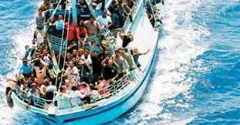
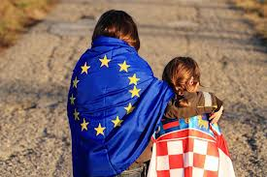

IS THE UNION FOR THE MEDITERRANEAN
THE BEST ANSWER?
The Italian European semester should be used to:
the revision of «governance rules», to transform the European Union in a political Union.
National States have to be overcome: a difficult task, since historical, cultural and socio-economical differences and convenience;
B) shift politic attention from the problems of European and eastern Baltic to the problems of the Mediterranean area;
C) politically and economically re-centralize the Mediterranean area.

Slide 33

4.
WHICH EXIT STRATEGY
FOR
THE “MEZZOGIORNO”
OF ITALY?

Slide 34

AN «INDUSTRIAL LOGIC» TO EMPOWER
THE “MEZZOGIORNO” OF ITALY? /1
The European Treaties are characterised by a “liberalism of solidarity“. In particular, the dimensions which explain this “liberalism” are:
In fact, the gap between the North and the Mezzogiorno of Italy has to be considered an european issue, and not only a national one.
It is crucial to counteract the «Mezzogiorno question» with an «industrial logic», by adopting an organisational and productive rationality, applicable in all sectors, to overcome wastes and welfarism (A. Quadrio Curzio).
Eventhough the Mezzogiorno of Italy has many excellent entreprises, they are not strong enough to generate manufacturing ecosystems able to determine an endogenous development.
the free circulation of persons;
a disciplinated immigration;
a fair economic competion;
an equilibrted and sustainable growth;
social and territorial cohesion.
Nevertheless, an excess of fiscal constrait during the global crisis and a lack of shared policies on immigration, have contributed to the persisiting gap between South and North of Italy, which is the worst among Eropean countries.

Slide 35
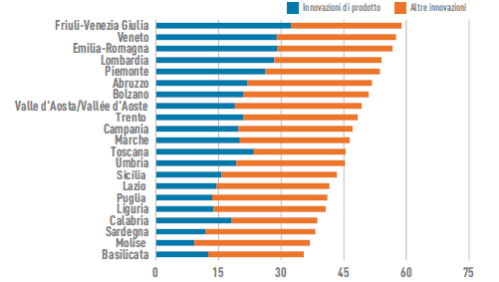

AN «INDUSTRIAL LOGIC» TO EMPOWER
THE “MEZZOGIORNO” OF ITALY? /2
In every economic sector, the productive tissue is fragmented and the lack both of institutional and social infrastructure, and tangible and intangible goods is very serious.
That’s the reason why the Mezzogiorno of Italy, an area with 26M of inhabitants, still remains one of the weakest regions in Europe.
Innovative enterprises (2008-2010)
Product innovation
Other innovation

Slide 36
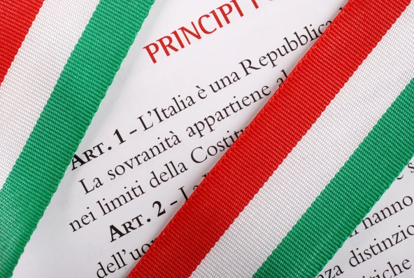

EXIT STRATEGY? /1
Moreover, many Institutions have not been able even to use the European structural funds.
Two remedies have been identified by Quadrio Curzio:
a strong application of the principle of subsidiarity, which is a fundamental one since the European Union foundation;
2) the reform of the “Title V” of the Italian Constitution by:
a) introducing a fiscal federalism based on a variable geometry;
b) increasing the “power of substitution” with which the State can intervene when the local Governments are inefficient.

Slide 37

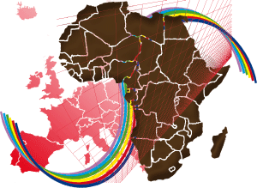
EXIT STRATEGY? /2
The South of Italy is dangerously becoming more a lonely and dying iceberg than a marginal contributor to the European multidimensional vitality.
Beside a national solution, is it therefore possible and necessary to think about an international solution?
  THE UNION FOR THE MEDITERRANEAN
  and
  AN EURO-AFRICAN UNION
  ARE THE ONLY EXIT STRATEGIES?

Slide 38


EXIT STRATEGY? /3
How can Sicily, Sardinia, Calabria and Apulia, for example, in an era of macroregions and globalisation, still persist in searching individual economic and politic “attention-seeking”? How could a single region be the driving force for the development of the Mezzogiorno area and the Mediterranean area?
But national and international efforts cannot be sufficient to empower the “Mezzogiorno wellbeing”.
In fact, it is decidedly crucial and essential a common political action shared by all the regions of Mezzogiorno.
Only a joint political and economical programming of the regions owning to the “Mezzogiorno of Italy” could ensure a "mass impact" sufficient to shock an atavic and enduring backwardness.

